Slide 1


Slide 2

title : - “ PERFECT PICTURE POOL ”

Slide 3

Project Supervisor
Dr. Vipin Kumar
Team Members
Deepanshu – 2100290140056
Shipra Aggarwal – 2100290140125
Shivani Pandey – 2100290140130
Rashi Ruhela – 2100290140112

Slide 4
INTRODUCTION
The title of the project is “ Perfect Picture Pool ”.
This project will handle the activities of the Registered Users.
User can register himself and then login.
Admin is set different types of contest on website in which anyone can participate.
Then he would be able to upload any category of image like png, jpg, icons etc on his/her account handle that he created.
Anyone can vote on any image that user upload whether he is register or not.
Anyone can give feedback, suggestion and also they can leave the comment on the image. By this website, User can know their skills and where they have to improve it and also they upgrade their picture clicking skills. User also motivate by this website when they saw their results.

Slide 5
TECHNOLOGIES USED
FRONT END
Bootstrap
React
BACK END
Java
NodeJs
Oracle

Slide 6
SOFTWARE REQUIREMENTS
VS CODE
ECLIPSE

Slide 7
MIININMUM HARDWARE REQUIREMENT
PROCESSOR 11th Gen Intel(R) Core(TM) i3
System Type 32-bit operating system
Speed 3.00 GHz
Hard Disk Space 256 GB
Ram Memory 4 GB
Operating System Window 8

Slide 8
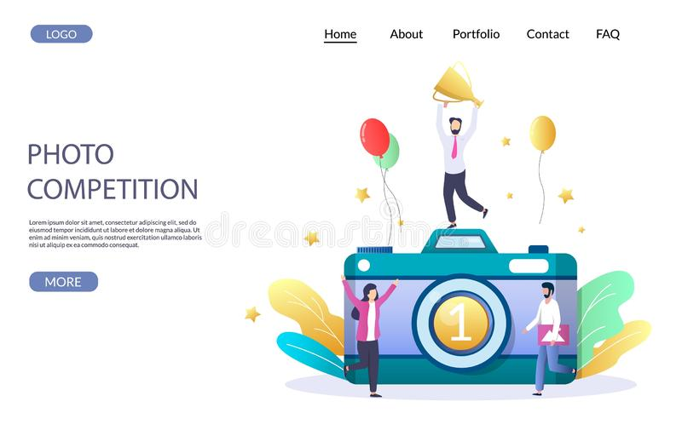
MODULES DESCRIPTION
Welcome Display
This is a first page of website that displays the welcome screen for the User & Admin.

Slide 9
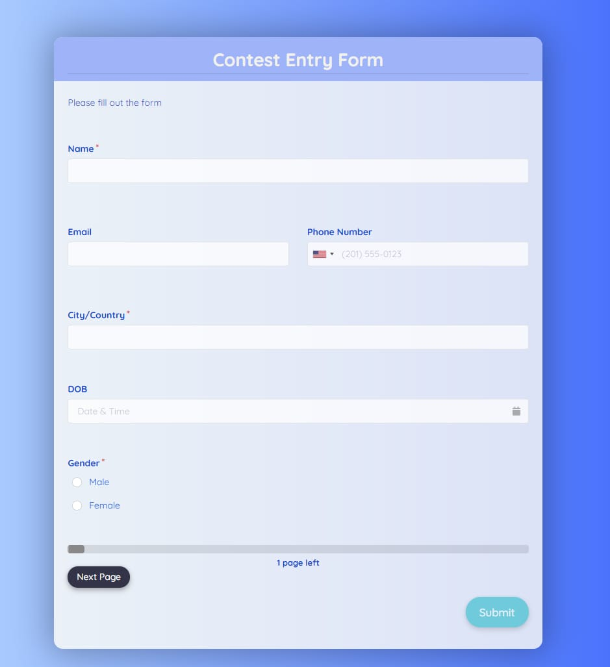
Register Page
This Page is a menu-based that displays the menu for register user details.

Slide 10
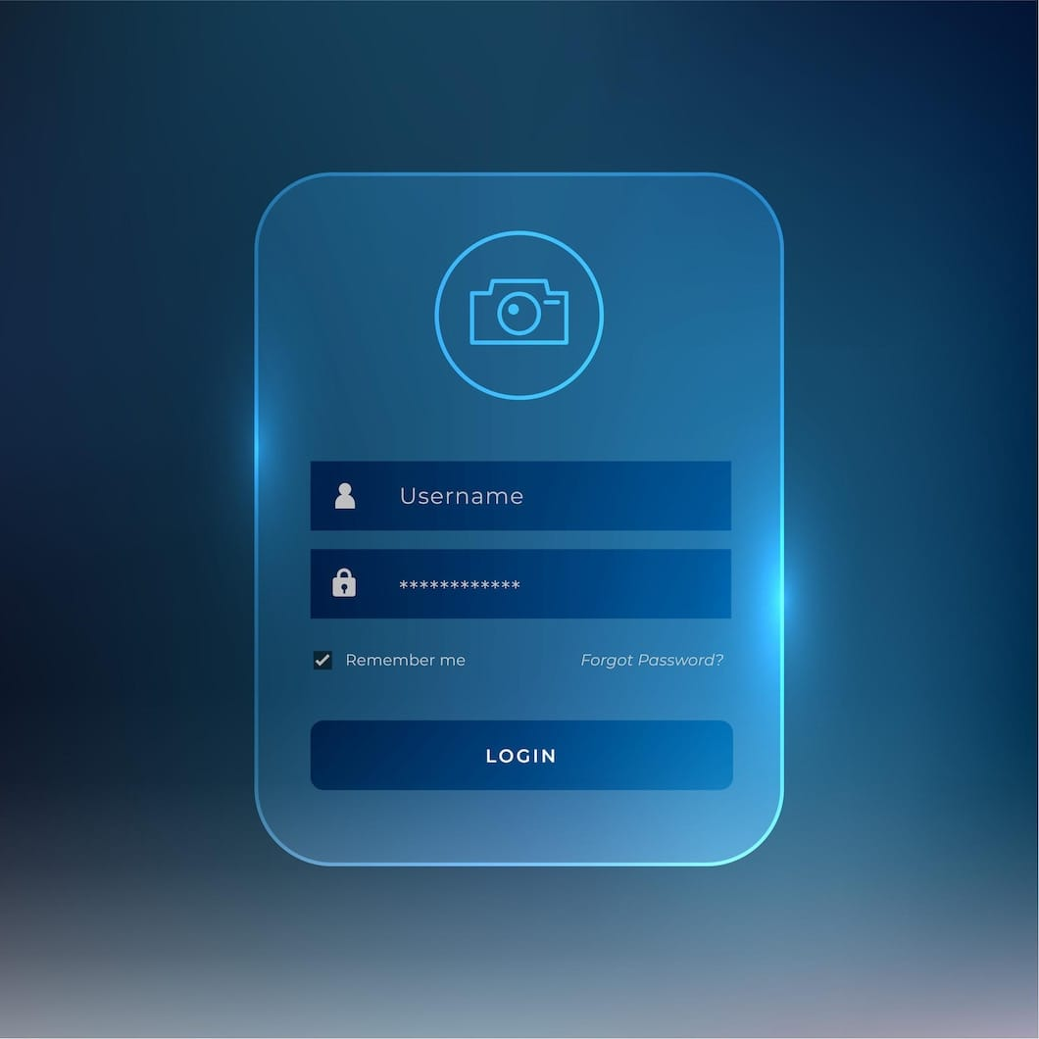
Login Page
This Page shows the Login name and password when user enter a valid user name and password then he/she can operate their account.

Slide 11
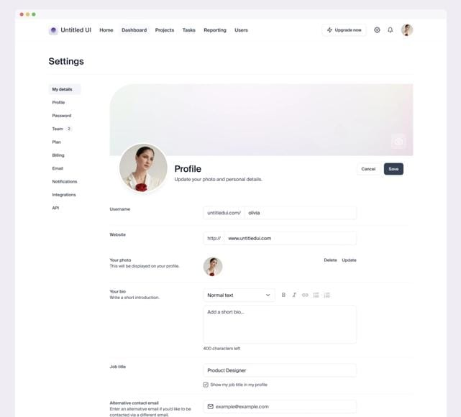
User Page
This Page is a menu-based that displays the menu for operation of the website. It includes various options like edit profile, feedback, add images, delete Images, manage account related option.

Slide 12
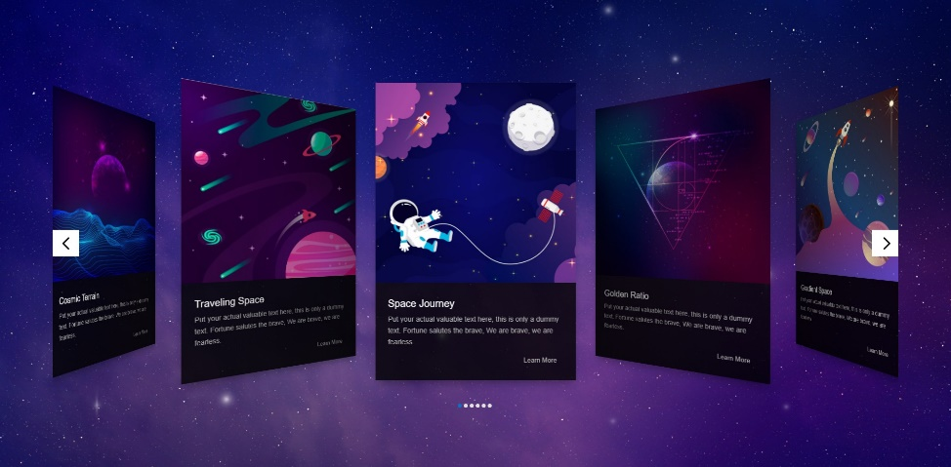
Contest page
This Page is display about different contest that is going on.

Slide 13
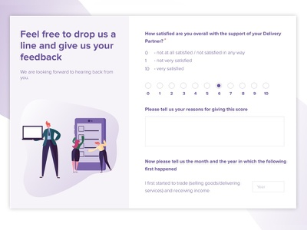
Feedback page
User can give feedback according to their analyse.

Slide 14
REPORTS / OUTPUTS
The “ Perfect Picture Pool ” Website is developed for giving the output like list of the winner according to their rank which are decided weekly on the basis of likes and comments on their images like png, jpg, icons, favicons etc.
Anyone can go through on this website and access.
Anyone can also give the feedback on this website and By this feedback, User can easily know where they have to work and how they upgrade their skills regarding their photography.

Slide 15
CONCLUSION
The “ Perfect Picture Pool ” Website is developed using different Web Technologies meets the objectives of the system for which it has been developed.
The system is operated at a high level of efficiency and Admin and user associated with Open Source website. The website is spread creativity among people.

Slide 16
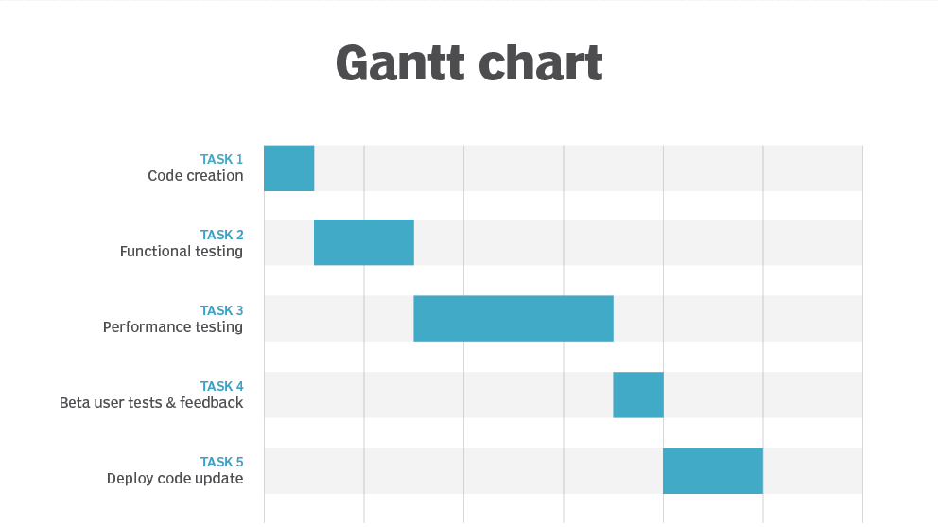

Slide 17


